Slide 1
IST 659: FINAL PROJECT
Title: Database Management System for Athleisure
By Ameya Rajesh Kelaskar and Sushil Sunilkumar Deshmukh
Aim of the project:
To create a database management system for both the Customers and employees of Athleisure, a company
that deals in sporting goods.

Slide 2
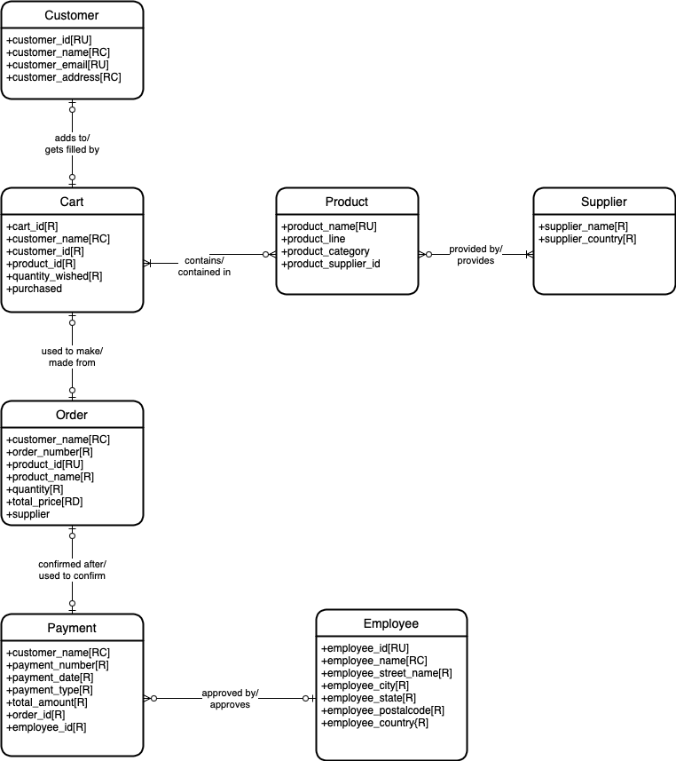
Conceptual Model

Slide 3
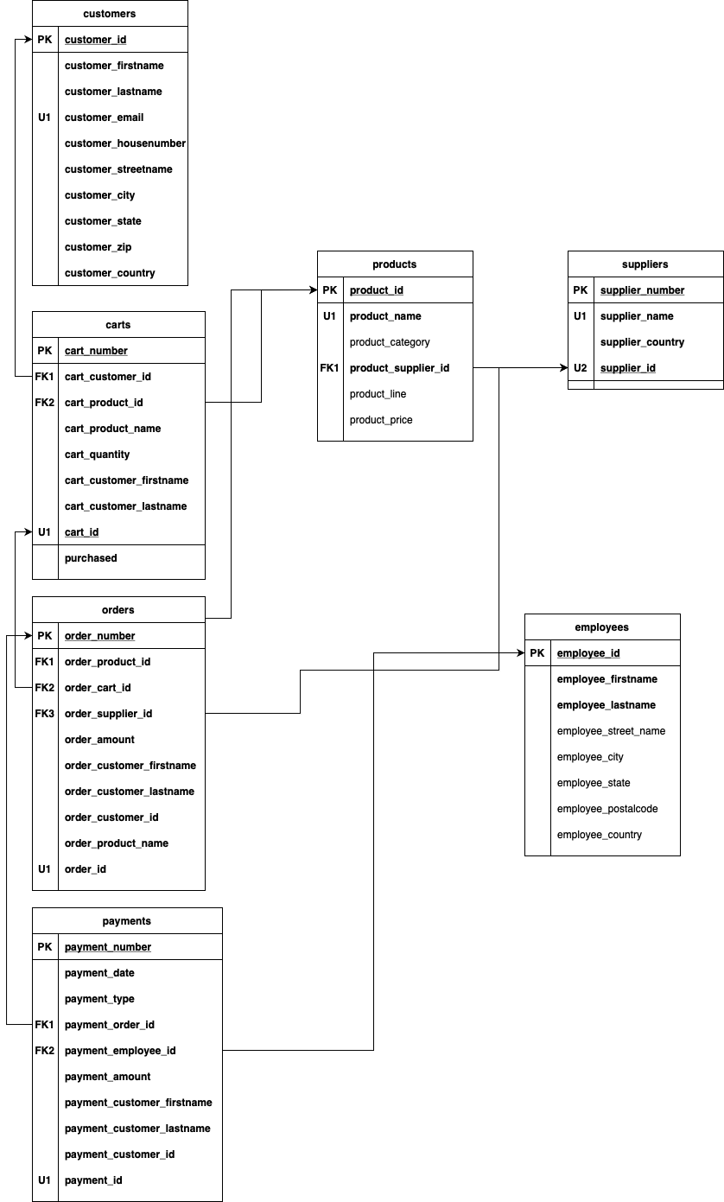
Relational Model

Slide 4
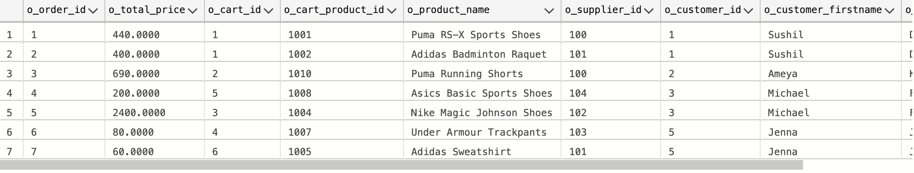
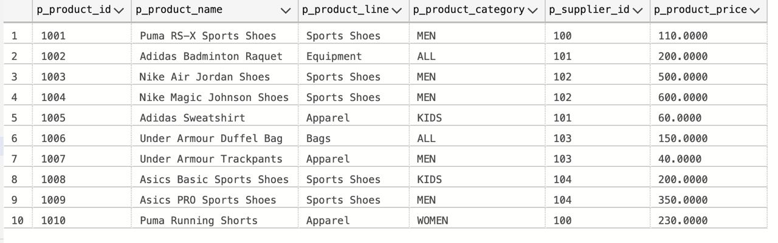
Table Data
Orders
Products

Slide 5
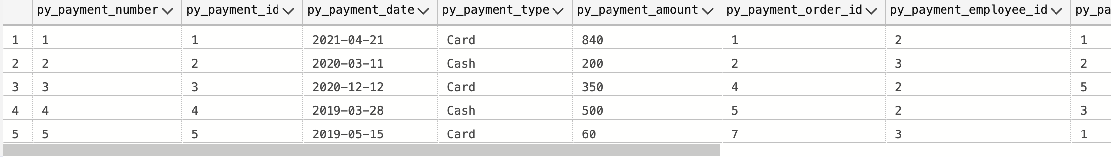
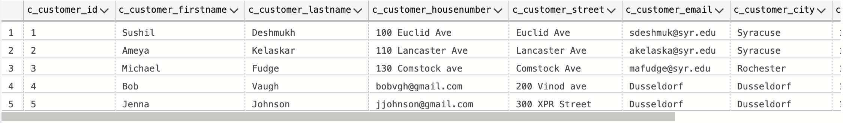
Table Data
Payments
Customers

Slide 6
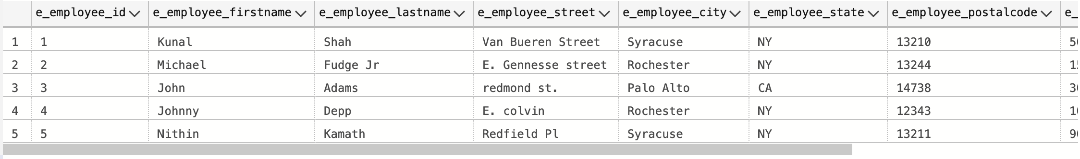
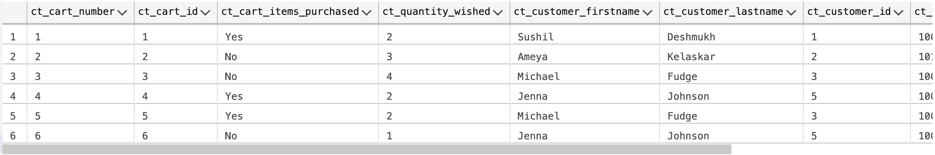
Table Data
Employees
Carts

Slide 7
Workflow of the PowerApps Application
Main Screen
Customers
Products
Employees
Product Details
Login Page
Employees Directory
Orders Placed
Suppliers
Employees
Employee Details
Orders
Order Details
Supplier Details

Slide 8
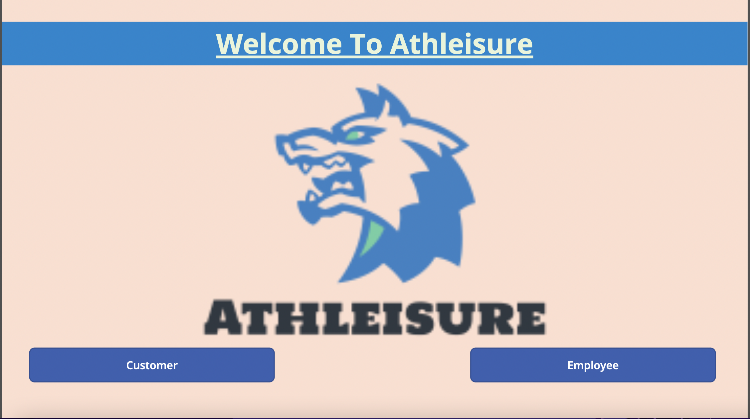
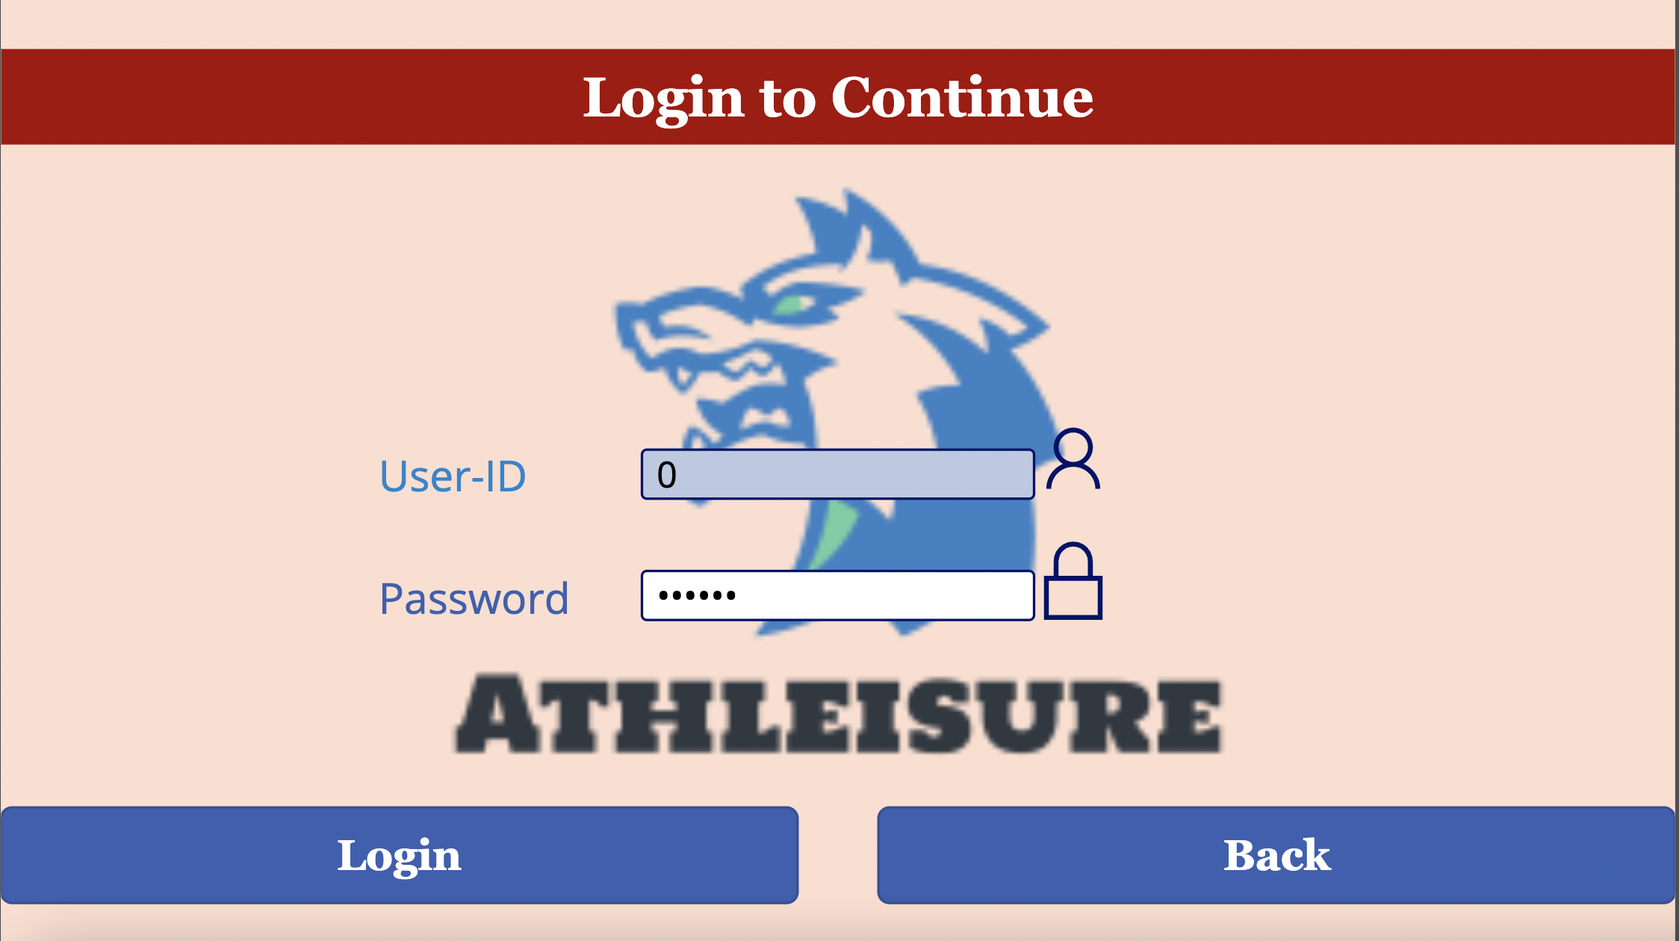
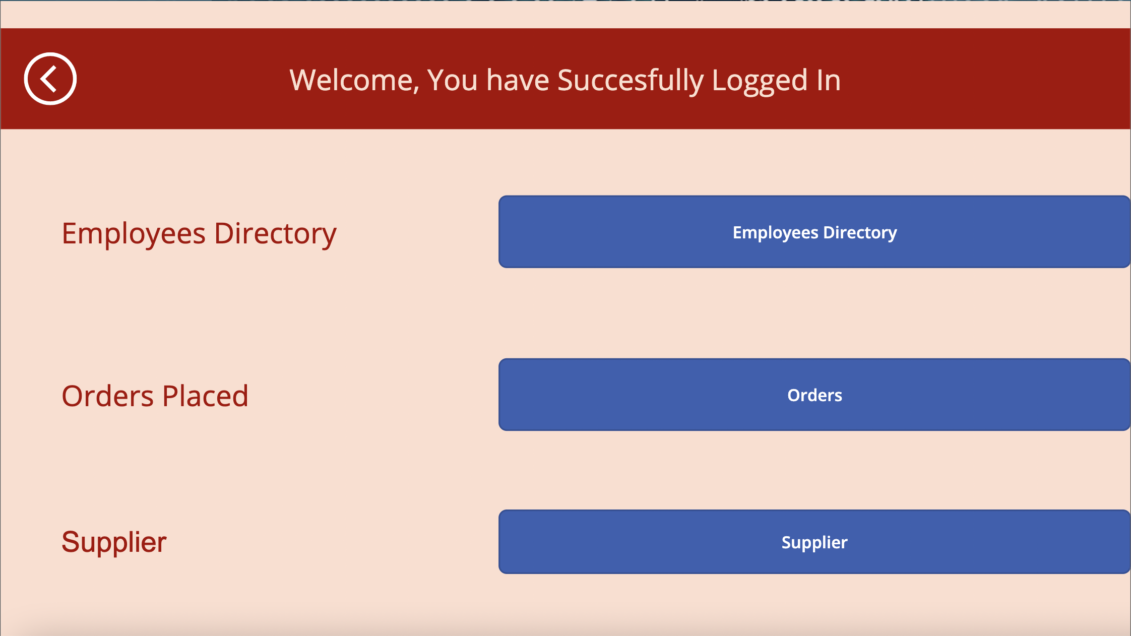
PowerApps Application GUI

Slide 9
Future Scope
A full-fledged database and database management system for the company.
Moving front-end and back-end to Cloud.
Adding more features like:
a. Integrating analytics into the database.
b. Placing orders.
c. Automating payments
d. Automate data updating.

